Slide 1
The Software Development Life Cycle
AP Computer Sciecne A

Slide 2
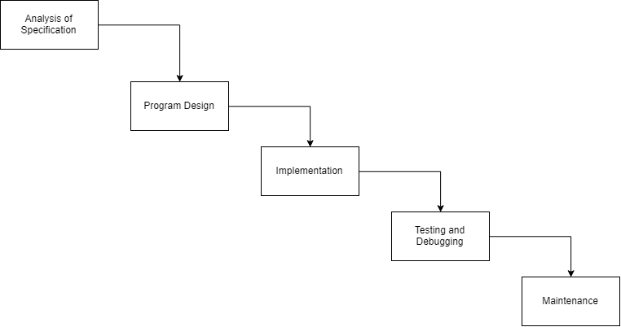
The Waterfall Model
The waterfall model was created in the 60’s to add some formality to how large programs are created. Each step flows into the next, which is why it resembles and is named waterfall.

Slide 3
Program Specification
The specification is the written description of the project.
It typically comes in the form of an overview of how the program will work and a list of requirements that the program must fulfill.
It usually comes directly from a costumer, or a business analyst will analyze the needs of the costumer and write the specification based on those needs.
Keep in mind that the people writing these things likely have never seen code in their lives!
Make sure you understand the specification 100% before moving on and clarify any questions and concerns with the costumer and/or the BA.

Slide 4
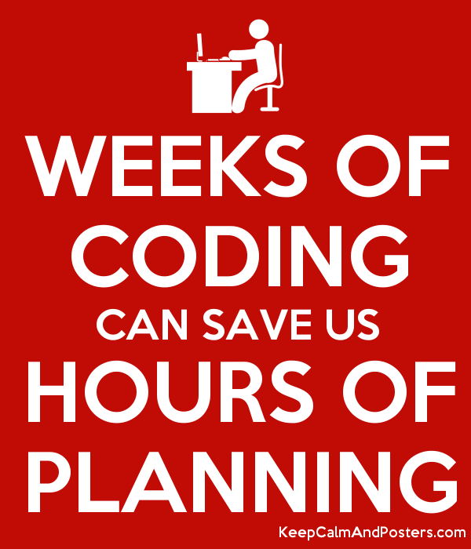
Program Design
This is the planning stage.
Program design is when decisions on how the solution will be developed are made. This not only includes things like what technologies and languages will be used, but also what structure and paradigms the program will follow.
When using OOP, this is also when objects and their relationships are planned out.
This step is done without any code being written, and is often ignored by beginner programmers, but should not be.

Slide 5
Program Implementation
This is the part where we programmers come in!
This is the coding stage; we will talk about this and Object Oriented Design later on.

Slide 6
Testing and Debugging: Test Data
In many programs, the possible combinations of input values is so large that it will be impossible for any human to test them all in their lifespan.
To work around this, a good programmer/QA Tester will select representative test data.
Usually, values that are within the valid range should be selected, endpoint values, and out of range values.
For example, if your program is expecting numbers on the interval [0, 100], then the test data should include a number on interval (0, 100), the numbers 0, and 100, a negative number, and a number greater than 100.

Slide 7
Testing and Debugging: Types of Errors
There are three types of errors:
Compile-Time/Syntax Error
Runtime Error
Intent/Logic Error
We will dive deeper into these in the next lesson.

Slide 8
Testing and Debugging: Robustness
Never assume that the end user of your program is as smart as you or knows as much about the program or computers as you. In fact, always assume the exact opposite of these things.
Always write programs that are robust. In other words, programs that:
Won’t give inaccurate answers for any input data.
Doesn’t crash on invalid input.
Doesn’t allow for program to continue when given bad input. This may mean continuing to prompt for input until the input is valid.

Slide 9
Program Maintenance
This is where most new programmers join projects. When the initial development of the program is complete.
Many things may change for programs in this phase, including the specifications changing, new features needed, untested bugs found.
Solid documentation within and outside of the original code makes this much easier, since the people maintaining code are likely not the original authors.
Without these things, messy legacy code that may have several issues may become completely untouchable.

Slide 10

Any Questions?

